Slide 1
Chapter 14
Future Challenges for Knowledge Management

Slide 2
Objectives
Intellectual Property Issues
How to Provide Incentives for Knowledge Sharing
Additional Challenges for KM
KM and Innovation
What’s Next?
Concluding Thought and all review

Slide 3
Introduction
The major challenges facing KM include people or cultural issues, an overemphasis on technology, conducting KM in isolation from business goals, ignoring the dynamic aspects of content, and opting for quantity of content over quality.

Slide 4
Introduction
The paradox of value - the harder-to-manage-knowledge is often the higher-value knowledge.
How do copyright (and copyleft) and other intellectual property issues impact KM?
How can knowledge be shared without losing attribution and without false attribution?
How can KM address the objective of innovation and creativity in addition to efficiency through reuse?
What is next on the horizon?

Slide 5
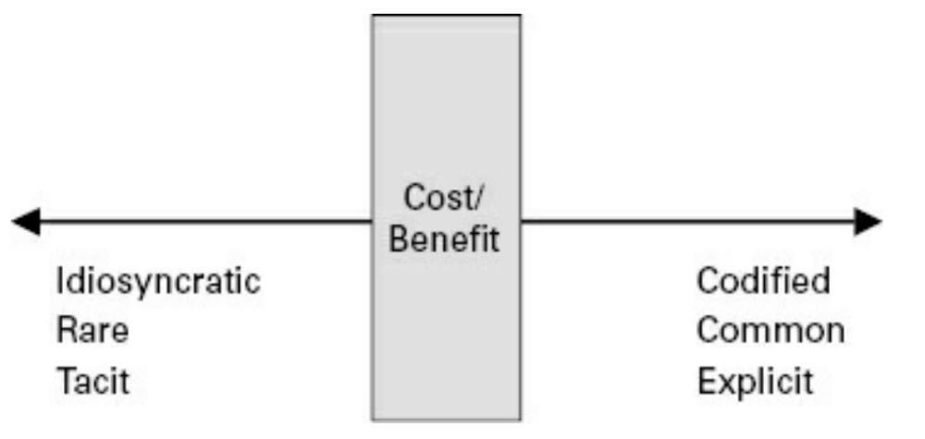
Introduction
The “paradox of value” (Boisot, 1998) lies in the fact that the easier it is to extract the knowledge, the less value it actually embodies. That is to say, the more the knowledge is tacit, the greater its value

Slide 6
Intellectual Property Issues
Two dimensions need to be considered for KM applications:
  The first is that when discussion occurs around intellectual property and authorship—even ownership—of content to be posted and shared company-wide, the concerns need to be further elucidated.
The second issue is related but is almost the exact opposite of attribution:
  Authors are also very concerned that once the knowledge is out of their hands it will become modified, watered down, invalidated or otherwise modified, and still attributed to them.

Slide 7
Intellectual Property Issues
One of the best means of mitigating such circumstances is to follow tried-and-true document management and version control best practices.
A second development may also aid the KM cause: the evolution of a “copyleft” revolution or reaction against some of the restraints imposed by copyright laws.

Slide 8
Intellectual Property Issues
There are four major permissions that are contained in Creative Commons licenses:
  1. Attribution (BY) requires users to attribute a work’s original author. All Creative Commons licenses contain this option, but some now-deprecated licenses did not contain this component.
  2. Authors can either not restrict modification or use Share-alike (SA), which is a copyleft requirement that requires that any derived works be licensed under the same license
  3. No derivatives (ND), which requires that the work not be modified.
  4. Noncommercial (NC) requires that the work not be used for commercial purposes.

Slide 9
How to Provide Incentives for Knowledge Sharing
The common and useful taxonomy developed by Callahan (2004) divides incentives into three broad classes:
  1. Remunerative incentives are said to exist where an agent can expect some form of material reward—especially money—in exchange for acting in a particular way.
  2. Moral incentives are said to exist where a particular choice is widely regarded as the right thing to do, or as particularly admirable, or where the failure to act in a certain way is condemned as indecent.

Slide 10
How to Provide Incentives for Knowledge Sharing
The common and useful taxonomy developed by Callahan (2004) divides incentives into three broad classes (con’t):
  3. Coercive incentives are said to exist where a person can expect that the failure to act in a particular way will result in physical force being used against him or her (or loved ones) by others in the community—for example, by punishment, imprisonment, firing, or by confiscating or destroying their possessions.

Slide 11
Additional Challenges for KM
Critical KM issues are often the reason why applications of KM fail. A KM strategy enables an organization to act proactively (acting before the problem occurs) rather than reactively (acting after a crisis has arisen).
Some good practices and lessons learned from organization’s experiences with KM to date could help guide us in being proactive.

Slide 12
Additional Challenges for KM
Some recommendations would include:
  1. Improving access to information and knowledge—covering the availability, accessibility, and affordability of information
  2. Promoting knowledge sharing through learning circles and vertical/horizontal coalitions, peerto-peer learning, knowledge networks, infomediaries, help desks, e-learning, and better interaction and mutual learning with target groups

Slide 13
Additional Challenges for KM
Some recommendations would include (con’t):
  3. Networking and international and regional cooperation—covering networking models, digital solidarity, collaboration tools like portals and common terminology, and network effectiveness, and strengthening existing structures and knowledge resource centers
  4. Including the development of local content in local languages and dissemination channels besides Internet, capacity building, and quality control and standards
  5. Avoiding weak incentives

Slide 14
KM and Innovation
A major reason for managing knowledge is to learn from what has been done already.
KM should facilitate and motivate those leaps of thinking to enhance individual creativity and organizational innovation capabilities (McElroy, 2003).
Whereas the first goal has been extensively addressed, the second KM goal of improving innovation remains elusive.

Slide 15
KM and Innovation
KM can help employees share tacit knowledge, which in turn can trigger innovation. Tacit knowledge, being harder to articulate, means it is also harder to duplicate—and is therefore more “protected” from competitors.
Pugh and Stewart (2013) make the case that KM can contribute to the innovation capacity of an organization.
KM practitioners are well positioned to be “great innovation conveners” as they often move across silos, are experienced facilitators of groups, and have the knack of being able to reflect on the past with an analytical eye

Slide 16
What’s Next?
The future of KM will mirror the key trends in organizations, namely increased collaboration in all work processes, synergy between information and knowledge management, and increased focus on innovation as well as on risk management and ethics.
Berry (2013) predicts that the inability to connect the dots and make sense of content that is widely scattered over different locations will cripple organizations to such an extent that they will see the effects in the quality of their products and services (and revenues).
Knowledge has never been so far removed from actions and decisions—which is what KM is all about.

Slide 17
What’s Next?
Cultural problems stem from the way we teach and train employees.
On the technological front, while there has been some movement on the standards front, there remains a dizzying proliferation of tools, technologies, and systems that continue to create data silos.
Valuable knowledge is located in just too many places and it is simply not possible to search and find it all.
KM - and IM - will need that ideal environment where access is personalized, customized, and packaged so that users can make use of to get their jobs done.

Slide 18
Summary
Some issues facing knowledge management such as intellectual property issues, how KM can contribute to innovation, and how to provide incentives for knowledge sharing to successfully incorporate KM into organizations.

Slide 19
Discussion / Homework / Team Activities
The “paradox of value” is one of the greatest challenges facing KM today. Do you agree with this statement? Why or why not? Provide illustrative examples to support your arguments.
KM often fails to live up to its ideal goals of knowledge sharing due to a lack of incentives. How would you set up a system of rewards and censures to motivate knowledge workers to share knowledge? What are some typical obstacles that you would expect to encounter? How would you address these obstacles? Outline an incentive strategy and describe how you would evaluate its success.
If after six months’ of effort you find your KM project is still not making headway, what actions would you take? What information would you seek out in order to decide the best course of action to take? How and when would you assess progress again?

Slide 20

Discussion

